Slide 1
Land cover classification and Planet imagery
Feb 11, 2019

Slide 2
Plan for using Planet imagery

Slide 3
Purpose of Planet images: create validation/training data
Validate crop timing information
Need high temporal resolution
My current method involves stepping through images and manually entering estimated planting, harvest dates for each field
Validate land cover classification for single vs double cropped soy (for places known to be soy)
Need because want to report difference in crop timing behavior for different cropping intensities
Current land use map doesn’t separate single vs double cropping well
Training data for land cover classification of soy vs nonsoy agriculture
Important because ‘bad’ timing estimates are usually due to misclassified land use
We have very few training points for nonsoy agriculture
If need to create training data for this from Planet, need calibrated images from a consistent set of satellites, need to calibrate with Sentinel 2?
Validate land cover classification agriculture vs natural veg
Important because ‘bad’ timing estimates are usually due to misclassified land use
Notes:
Soy vs not soy: planet has red edge band, so spectral data. Figure out phenological difference of soy. Look at Sentinel data. Planet data is tricky because calibration doesn’t really work out. Sentinel has more rigorous/standard calibration. It started in 2015. Go with Sentinel instead of Planet. Is 20 points enough- it’s enough if those 20 points only represents a single
Can look visually to see if something is soy vs not soy. Look for patterning of the crops. Go to Google Earth Pro. In ArcGIS, create random points and see if you can tell the difference between what’s soy vs not soy and see if can visually see a difference, esp in a specific season. Find a year that’s data rich that’s recent and do a slide bar over. Do scatterplots band by band over soy vs non soy points to see what bands might be separating soy from nonsoy. Multiband indices might be able to highlight differences.
Where to get training points? Spatial coverage is important. Basic rules: for both training and testing points, 10x the number of bands per class. For training, 30 for training at least for statistical purposes. Recommend 50 samples per class. If pixels are coming from same field, would want 50 of those clusters. For testing, 50 per class.
Assuming identical bands (i.e. atmosphere correction), can pool years’ worth of training/testing data to train a single classifier. Another issue: when pool years together, try to stick with MODIS. Doing mosaic will shift the actual date of acquisition and this may introduce error.
Test whether variability within SC/DC soy is more than variability between soy vs nonsoy.
Need to get more ground truthing – especially for more recent years.
Temporal principal components – input is time trajectories of individual pixels, feed it into PCA, and look at first few components – get the principle trajectories that give the most variation. See which pixels have a high correlation with each trajectory. It will show me the variety of soy timing, do it for my big dataset of soy. Can see where/if people are failing on their first crop.

Slide 4
Training data for land cover classification of soy vs nonsoy agriculture
Need this because:
False positive of soy in land use map is very high (around 50 – 60%), and we don’t want to report timing information for agriculture that’s not soy
Want to make sure the Planet imagery downloaded for timing/SC/DC validation purposes is indeed soy
However, the training data for non-soy agriculture is very sparse (500 SC/DC soy points, 15 nonsoy points per year)
Currently, train and apply classifier only for individual years; maybe pooling all years’ training data will help
Is it possible to train a soy vs nonsoy classifier in e.g. Kansas and use it in Brazil? (Crop timing issues…)
Is it possible to visually identify soy vs other agriculture from Planet images? (i.e. create more training points from Planet?)
Year | Overall accuracy | True positive | False positive
2014 | 95 | 453/(453+17) | 7/(11 + 7)
2003 | 92 | 348/(348+13) | 16/(14+16)
2004 | 90 | 324/(324+23) | 10/11
2007 | 96 | 397/(397 + 2) | 14/(14+7)
2017 | 96 | 412/(412 + 8) | 9/(9+8)
For downloading Planet images known to be soy, because false positive is so high, can’t rely on land use map to target soy-only agri.
Currently, only downloaded Planet images over farms that are known to be soy
Could also download Planet images with a high concentration of soy training points, but the training points don’t cover all of Brazil

Slide 5
Center pivot classification

Slide 6
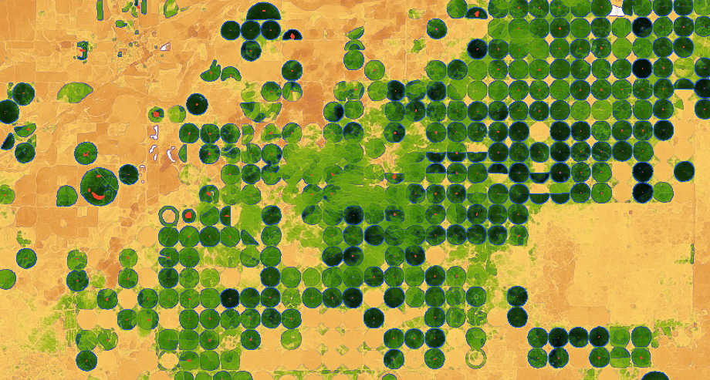
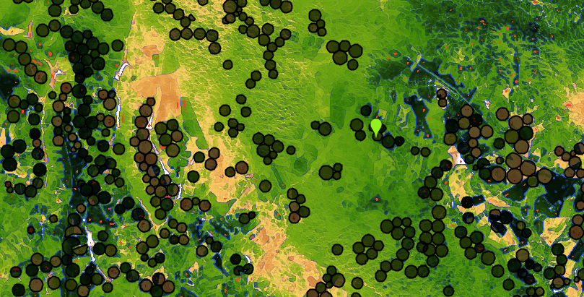
Center pivot detection in Brazil
Need to detect center pivot because only have one year of center pivot data
Method is based on edge detection. Red = center pivot’s centroid. Black circles = 2014 center pivot data
Kansas, using Landsat 8 day EVI in April 2013
Brazil, using Landsat 8 day EVI in April 2013
Observations:
No obvious ‘out of season’ time during which irrigated would be green and rainfed would be yellow
Size of center pivots is very uniform in Kansas but more varied in Mato Grosso, is a problem for creating a single kernel size in edge detection
Irregularly spaced center pivot and heterogeneous natural vegetation make it hard to pinpoint actual center pivot (problem for edge detection). False positive and false negatives are very high
reduceToVectors to convert from detected pixels to features is not scalable in GEE
Potential solutions:
Object oriented classification; machine learning. Other solutions?
Notes:
Try to identify time of the year during which there is at least some contrast. You’re trying to separate circular features from other features. First find crops by looking at the min and max EVI, then on the differencing results, find the circle, then do object based classification. Take annual max minus annual min. Looking at Sentinel has higher revisit time.

Slide 7
Planet Scope satellite calibration

Slide 8
Planet Scope vs Rapid Eye images
How to calibrate to each other to use to create a single timeseries?
Need to calibrate to Sentinel to get accurate EVI? (what calibration method/tools to use?)
Commercial high resolution satellites that are useful for calibration?
They are top of atmosphere – is there an atmospheric correction algorithm available?
Existing cloud filtering algorithm for Planet Scope and Rapid Eye?
Python API – filter for cloud cover over specific regions of the image?
Notes:
Combining Planet Scope and Rapid Eye – calibrated quite differently. Need to calibrate with metadata using API, won’t be very scalable. Use Sentinel because it’s more forward looking.

Slide 9
Automated detection Planet imagery characteristics

Slide 10
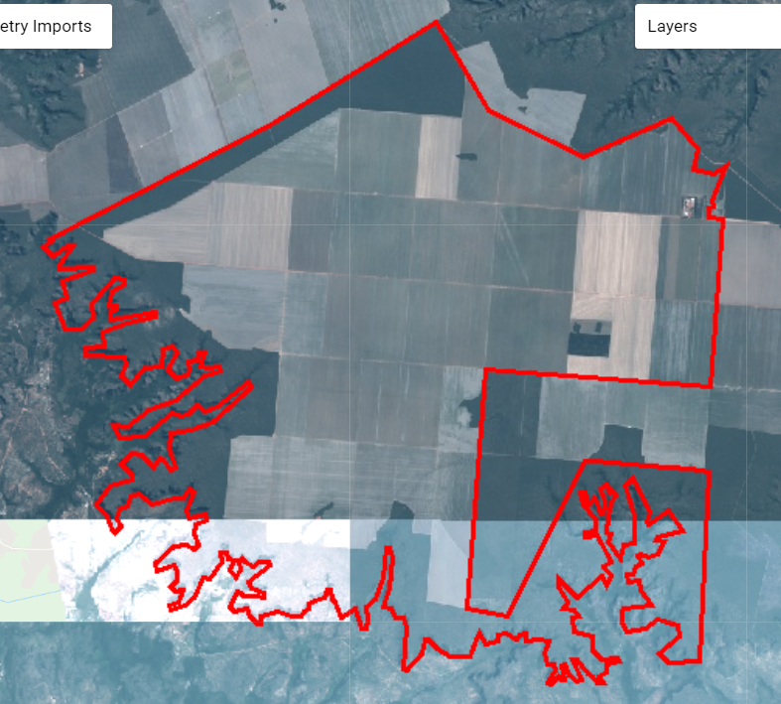
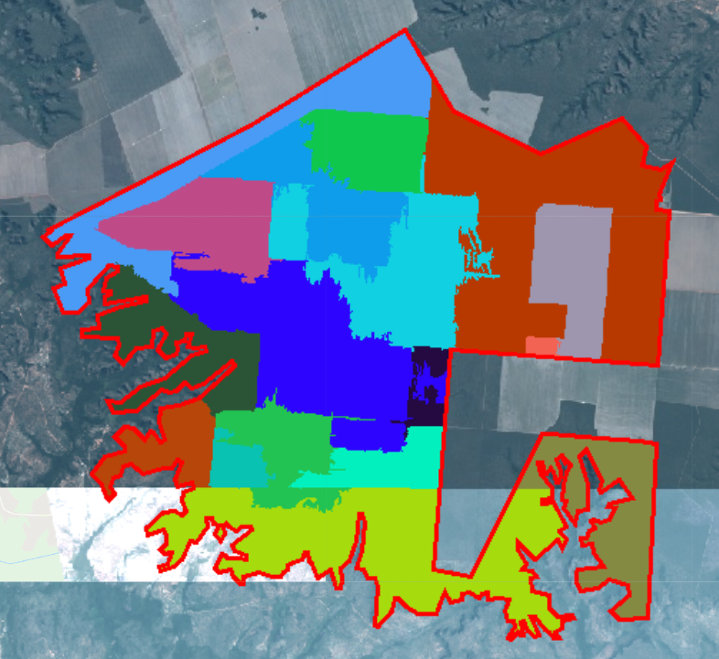
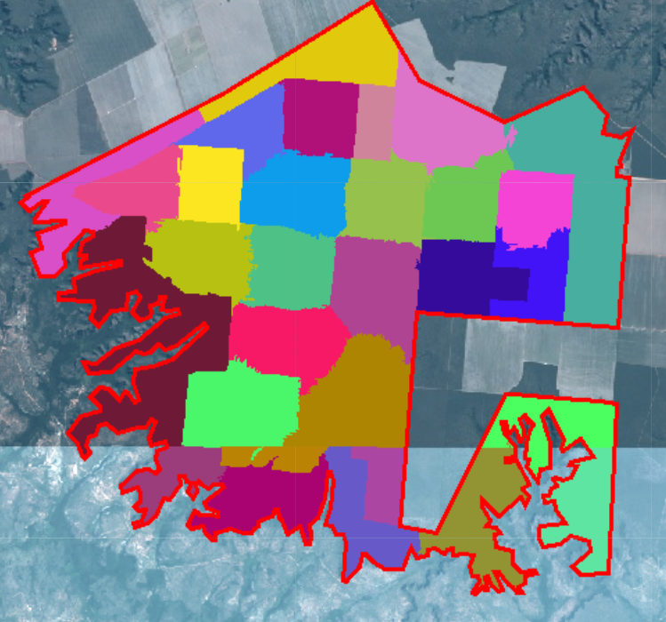
Automated workflow?
Currently, manually examine and download Planet images online; manually upload as GEE assets; manually divide Planet image into fields (each has its unique timing), manually enter estimated planting/harvest dates
Automation:
Planet Python API and GEE connection
Download images that are cloud-free over specific regions?
Automatically upload as GEE asset, or a way to use the images in GEE without uploading as asset?
Use image segmentation algorithm to separate image into agricultural fields
For each field, do simple peak detection method: find dates with the five highest EVI values, look at how dates are spread over the year. This will determine single vs double cropping. Other peak detection method?
A way to get planting/harvest date automatically?
Mosaic of Planet Scope cloud free images, 2017 - 2018

